Slide 1
The Israeli economy: Key challenges and the potential of EU-Israeli economic relations
Heliodoro Temprano Arroyo
(Adviser, Directorate General for Economic and Financial Affairs, European Commission)
Eli Hurvitz Conference on Economy and Society 2019
(Jerusalem, 17-18 December 2019)

Slide 2
Outline and main messages
The Israeli economy has been performing strongly over the last 15 years: a look at the key achievements.
But it is still facing a number of significant challenges.
The EU is Israel´s main trading and investment partner.
And Israel has on of the highest level of access to EU programmes among the ENP countries.
Israel is also already benefitting from incorporating certain EU regulatory frameworks.
There is potential for further strengthening our economic links and cooperation. But certain political preconditions must be satisfied.

Slide 3
Key achievements: the long view
Israel has been growing much faster than its OECD partners since 2006, with GDP growth averaging almost 4% and the economy showing significant resilience to episodes of global or regional financial turmoil.
This has allowed the Israeli economy to further converge towards average OECD per capita income levels.
Innovation has thrived: the Israeli high-tech sector is famous for its start-ups and also includes many major technological companies and R&D centres.
The performance of the labour market has been outstanding, with the unemployment rate falling to the lowest in OECD and the participation rate shooting up. And this despite an important migrant inflow!*
Real wage moderation has helped produce this result.
Notes:
*As a result, the employment rate has increased sharply and it is now the highest in the OECD!

Slide 4
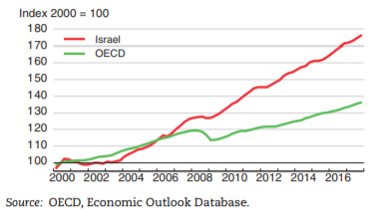
Israel has been growing much faster than the OECD average since 2006

Slide 5
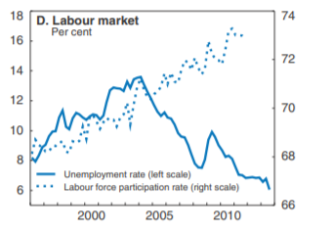
Israel: unemployment rate down to historical level while participation rates have shot up
Source: OECD, STEP 94 database
Notes:
*The unemployment rate fell to only 4% on average in 2018 and further to 3.7% in Q3 2019.

Slide 6
Key achievements: the long view
And inflation has been reduced from close to 6% in 2008 to the +-1% range since 2014 (0.9% on average so far in 2019).
There has also been substantial fiscal consolidation since 2004, supported by the compression of defence expenditure and the introduction of fiscal rules (though the rules have not always been respected), leading to a substantial reduction in the public debt ratio.
The external position has strengthened markedly, supported by the exploitation of the off-shore gas fields.
Thus, the current account moved into surplus in the mid-2000s and the surplus has averaged about 4% of GDP in the last 5 years, Israel is also receiving substantial FDI inflows and official FX reserves have risen consistently since 2009.*
The banking system is sound (well capitalised, loan quality, profitable).
Notes:
The current account surplus is likely to further increase (towards 4.5%-5.5% of GDP) in the coming years as natural gas exports from the huge Leviathan field begin in 2020.
Official reserves stand now at an impressive 120 bn (excl. gold), or nearly 13 months of imports.
The net international investment position has moved from -40% of GDP in 1999 to 40% of GDP in 2017!
Tourism has been booming: Israel received last year 4.1 million tourist and 3.3 million in Jan-Sept of this year (a 13% increase). The Ministry of Tourism now hopes to meet its target of 5 million tourists in the coming years.

Slide 7
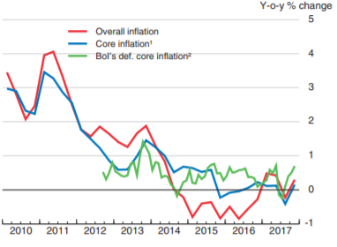
Inflation in Israel
Source: OECD, Economic Outlook database

Slide 8
Israel – Progress with fiscal consolidation
(in % of GDP)

Slide 10
But not all is a success story
The productivity gap: a dual economy
Poverty and inequality
High cost of living and elevated house prices remain elevated, despite recent moderation
Fiscal risks rising again
Dutch disease and external competitiveness
A regionally isolated economy

Slide 11
The productivity gap
Per capita income growth has largely been explained by the expansion of labour and the capital stock. TFP has grown very slowly (almost stalled) since the mid-2000s. The flip side of the success in absorbing labour is low labour productivity.
Indeed, as the title of this conference suggests, Israel is a dual economy, with a dynamic high-tech sector but the remainder suffering from weak productivity.
Moreover, with the share of the Haredi and Arab population, characterised by lower participation rates and lower productivity, expected to rise very substantially, per capita income convergence will slow down.
Need to address reasons for weak productivity performance:
  Product market restrictions and lack of competition.
  Education (por PISA scores, particularly among for Israeli-Arab schools).
  Low quality infrastructure. Insufficient public and private investment.
Notes:
Advisable policy responses to foster productivity growth:
Measures to ease product market restrictions and increase competition
Investing more in education, especially of Haredi and Arab populations
Improving infrastructue, by fostering public and public investment in infrastructure, while keeping debt dynamics under control (PPPs, improving the business environment).
But in order to increase spending on education and infrastructure while ensuring fiscal consolidation, efforts to reduce defence expenditure should continue.
Measures to support GDP growth through an increase in the labour input:
- Measures to encourage participation rates of Haredi and Arab populations.
- Role of migration?

Slide 12
PISA scores are weak, particularly for Israeli Arabs, and have worsened again recently
Source: OECD
Notes:
While the gap on most of the indicators had shrunk between the early or mid-2000s and the mid-2010s, it has widened again since then!
Israeli Arabs score weaker than Hebrew population in the three indicators.
Haredi schools do not participate in the PISA test, but their inclusion would probably lower scores even further.
In this respect, the adoption in 2015 of a 5-year pan (2016-2020) for the economic development of the Arab population, which includes ambitious measures in the area of education, is a welcome step.

Slide 13
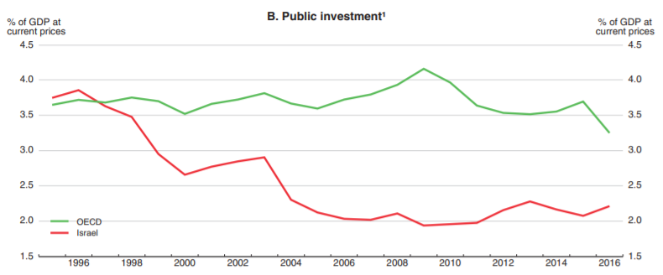
Public investment in Israel is insufficient, especially given rising population density
Public investment
Source: OECD
Notes:
*Transport infrastructure is particularly weak: rail network are underdeveloped and Israel’s roads are frequently congested. Also, lack of competition in the management of ports and airport has lowered efficiency.

Slide 14
Tackling poverty and inequality
Israel scores weakly among its OECD peers on measures of both poverty and inequality
While the tax and social benefit reforms (notably of child benefits) adopted by the Israeli governments between 2003 and 2010, encouraged work effort among the poor, helping to reduce market income inequality, they also weakened markedly the redistributive role of the State, increasing ex-post income inequality.
High poverty rates among Haredi and Israeli-Arab populations do not fully explain high poverty rates and inequality indicators: the problem is more general.
In this respect, Israel is not only a dual economy but also a dual society.

Slide 15
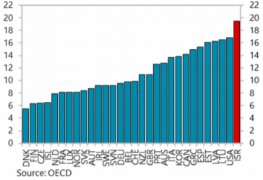
Relative Poverty (2015 or latest available)*
Notes:
*Share of the population with income below 50% of the median income.

Slide 16
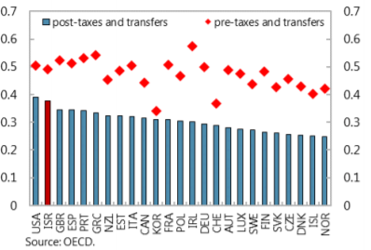
Gini Coefficient¹
(1) Average of Gini coefficients for 2010 and 2012

Slide 17
High cost of living and house prices
Combined with a high cost of living, including expensive child care facilities, and a boom in house prices and rentals, this complicated the life of many young and fertile families in cities such as Tel-Aviv or Haifa and contributed to the so-called Israeli summer of protests in 2011.
Insufficient competition in many goods and service markets, often characterised by oligopolistic situations, contributed to the high cost of living.
The boom in house prices resulted a combination of demographic and financial factors feeding demand and by supply constraints.

Slide 18
Certain appropriate responses achieved partial results but the problems remain
The Trajtenberg Committee report (Sept. 2011) provided recommendations but they have only been implemented in part.
Some adjustments were made in the tax and benefit system.
And there has been efforts to increase competition, facilitate food and other imports and ease product market restrictions
Also, the BoI has taken prudential measures to restrict risky mortgage loans and measures have been take to support house supply.
This has contributed to a deceleration in house and CPI inflation, also supported by the appreciation of the shekel. Together with faster wage growth in the context of a very tight labour market, this has eased cost of living pressures somewhat.
But house prices remain elevated. And poverty and inequality are still a problem.

Slide 19
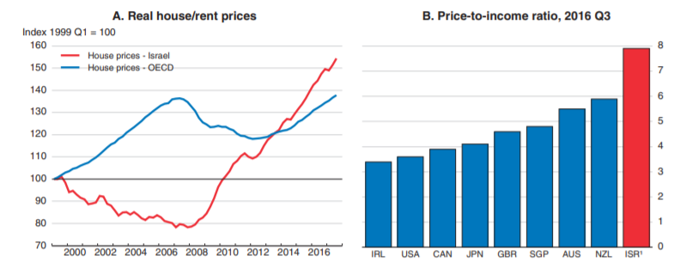
Elevated house prices
Source: OECD

Slide 20
Reducing poverty and inequality
Improving education and participation rates of the Haredi and Arab groups will not only foster productivity but will reduce poverty rates.
But a policy to reduce poverty and inequality cannot be limited to the Haredi/Arab population. It should also include more general policies, including tax reform, a careful strengthening of the social safety net, and a shift from expenditure in defence* and pensions to more progressive social expenditure.
Recent developments in Chile provide a warning sign: inequality is not just a fashionable academic and international debate.
Notes:
.

Slide 21
Fiscal risks on the rise again
Recent fiscal slippages warn that fiscal risks remain considerable.
And the extended campaign/electoral cycle has delayed adjustment
It is important to continue to reduce the weight of defence expenditure. While its share in GDP fell markedly from 2002 to 2010, partly reflecting a shift from heavy military expenditure to less costly intelligence-based defence, progress has stalled since then. At about 6%, it remains much higher than the OECD average. The other side of the coin is exceptionally low civilian spending.*
The fiscal rules can be refined (e.g. by reviewing the expenditure rule to accommodate much needed social spending and investment).
There is also room for selective tax increases.
Notes:
*Together with low public investment, this results in very low total government spending over GDP (a small state) compared to OECD average, despite much higher defence expenditure.

Slide 22
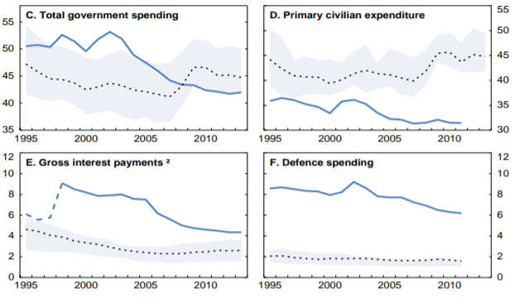
Still high defense spending; very low civilian expenditure
(in percent of GDP)
Source: OECD

Slide 23
The “Dutch disease”challenge
The impact of the off-shore gas discovery and exploitation.
A strong and sustained appreciation of the REER (see chart): is the Shekel overvalued, exacerbating the competitiveness problems stemming from weak productivity growth?
Perhaps but this is largely a normal macroeconomic adjustment phenomenon (natural resource discovery, Samuelson-Balassa effect…).
And there is some room to limit it: with inflation under target, BoI can keep interest rates low and conduct selective FX interventions (as it has been doing); tighter fiscal policy, deeper liberalisation of imports and…
…the stabilising role of the new Sovereign Wealth Fund, reinvesting abroad part of the gas bonanza (at least the excess tax, so-called Sheshinki tax)

Slide 24
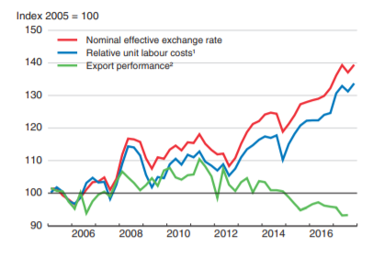
Exchange rate appreciation and export performance
Source: OECD

Slide 25
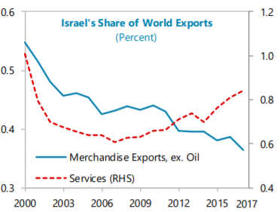
Merchandise export vs service export performance: the duality again
Source: OECD

Slide 26
Enhancing economic interaction with regional partners
The Israeli economy remains a small and isolated economy and, contrary to the usual belief, a relatively closed one,* with few direct trade or financial links with immediate neighbours.
There is scope for a selective development of those links, with potential mutual economic benefits as well as potential salutary effects on political relations.
Egypt, Jordan and Turkey provide some examples.
Palestine and the Peace Process**
  Potential offered by the East Mediterranean gas market, also as a platform for regional cooperation and stability.

Slide 28
The significance of EU-Israel economic relations
The EU is Israel´s largest trading and investor partner
The EU-Israel Open Skies Agreement: a great success
Research & Development: Horizon 2020 and its successor
Possible participation in InvestEU
Energy: the East Mediterranean gas market (again)
Participating in many other EU programmes and importing EU regulatory frameworks
Deepening the Association Agreement once the political preconditions are satisfied.

Slide 29
The EU is Israel´s main trading partner

Slide 30
Trade between the EU and Israel takes place under a Free Trade Agreement
Provisionally applied since 1996, it entered fully into force in 2000, as part of the EU-Israel Association Agreement.
The EU and Israel had already signed a FTA in 1975 but the Association Agreement and 2 subsequent protocols annexed to it (the last one entering into force in 2010) further liberalised trade in agricultural and fish products.*
And in December 2009, the EU and Israel signed an Agreement on Conformity Assessment and Acceptance (ACAA) for pharmaceutical products, which entered into force in 2013. By harmonising standards for these products, it greatly facilitates Israeli exports of pharmaceuticals, an important export sector in Israel. This was the first ever ACAA signed by the EU with Mediterranean neighbours (and the only one so far!).***
Notes:
*The 1975 FTA liberalised all Israeli industrial exports to the EU as from 1977 and all EU industrial exports to Israel as from 1989 and provided duty free entry into the EU for 70% of Israeli agricultural products.
**Israel has expressed interest in singing a similar agreement for cosmetic exports. While EU believes this type of agreement is less appropriate for the cosmetic sector, Israel’s recent efforts to align its regulations on cosmetics could help align them with those of the EU, facilitating our mutual trade in cosmetic without the need of a ACAA.

Slide 31
The EU is also Israel’s main FDI partner
Notes:
The participation of EU companies through mechanisms such as venture capital and M&As has strengthened markedly in recent years.
This surge in EU investment is particularly noticeable in the high-tech/start up sector.
A number of EU Member States are establishing tech-hubs and research centres in Israel. Some EU-level actors, such as the European Institute of Technology (EIT) are also seeking to establish their presence. And investment in SMEs/start-ups is being supported under the EU´s Horizon programme.

Slide 32
The EU and Israel signed in 2013 a successful Open Skies⁺ agreement
This Euro-Mediterranean Aviation Agreement is a comprehensive agreement that not only liberalises air traffic but also entails a significant degree of regulatory convergence.
It extends to Israel the benefits of the EU´s internal aviation market.
Since it started to be implemented in 2013, annual air traffic has shot up by about 1 million passengers per year.
Air fares have gone down by 15-40% and the number of connections with EU airports has increased from 43 to 91.
Ratification of the agreement still ongoing but expected to be completed soon, hopefully next year.
It should also support the development of tourism and business transactions between the EU and Israel.

Slide 33
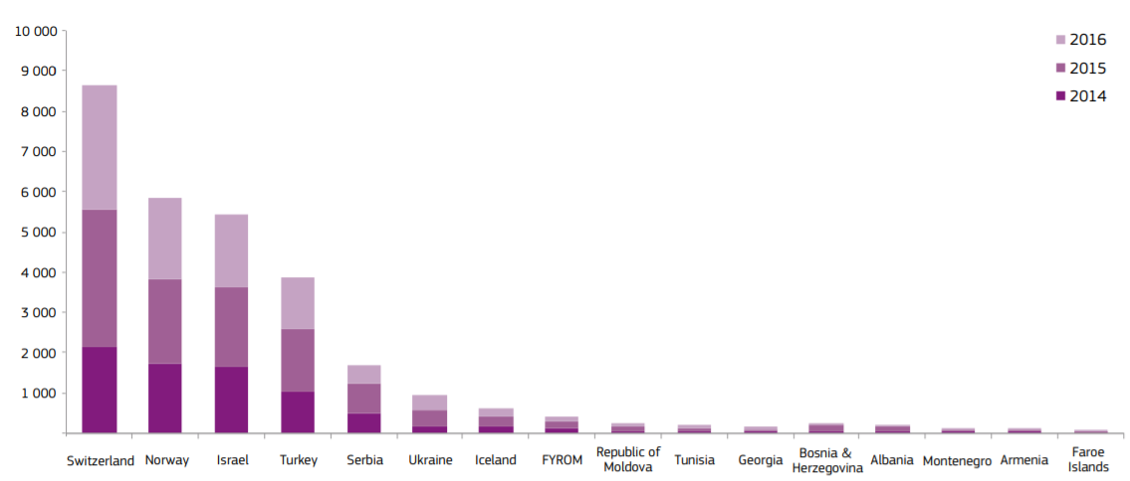
Israel’s participation in the Horizon 2020 programme
(number of research project applications)
Notes:
The 2020 Horizon programme (the EU´s Framework Programme for Research and Innovation for the 2014-2020 MFF), is to be replaced by the programme Horizon Europe covering the 2021-2027 MFF. In April 2019, the Commission proposed a marked increase in this programme, to EUR 94.1 bn from EUR 77 bn for the current Horizon 2020.
As an Associated Country, Israel can send observers to programme committees, contribute to discussions and consultations on priority topics, join certain initiatives open for participating countries and may participate in the JRC Board of Governors.

Slide 34
Israel could also benefit from the InvestEU programme
InvestEU is the EU’s flagship investment. It will succeed and expand the successful Investment Plan for Europe (“the Juncker Plan”). It is expected to mobilise, under the Commission´s proposal, at least EUR 650 bn in additional investments during 2021-27, mostly within Europe.
Certain parts of the programme (financed under its InvestEU Fund component) will be open to non-EU countries under certain conditions, allowing the implementation of projects in third countries.*
This includes in particular the financial instrument component of the Horizon Europe programme on research & development (the successor of Horizon 2020), which could be of particular interest to Israel.
Third countries can also benefit from cross-border projects covering both EU and neighbouring countries.*
Notes:
* For example, large infrastructure projects linked to Trans-European Networks).

Slide 35
Cooperation in the emerging East
Mediterranean gas market
There are important off-shore gas reserves in Cyprus, Egypt, Israel, Lebanon, the Gaza strip and possibly Syria.
The EU is a large potential market for this gas and cooperation with at least some of these countries is likely to develop in the coming years.
Israel is a founding member, together with Egypt, Jordan, Palestine, Cyprus, Greece and Italy, of the East Mediterranean Gas Forum, aimed at fostering regional cooperation in the gas area.
Different connection possibilities are under consideration, including through pipelines to Egypt’s LNG facilities and export infrastructure.
The EU could also cooperate in helping Israel upgrade the regulatory framework for the gas and energy sector, in an environmentally sensitive manner.*
Notes:
*The Israeli government has already been in discussions with the EU on a possible set of twinning programmes to strengthen the organisation, technical and administrative capacities of the Ministry of Oil and Gas Department as well as the regulatory framework for the gas sector.

Slide 36
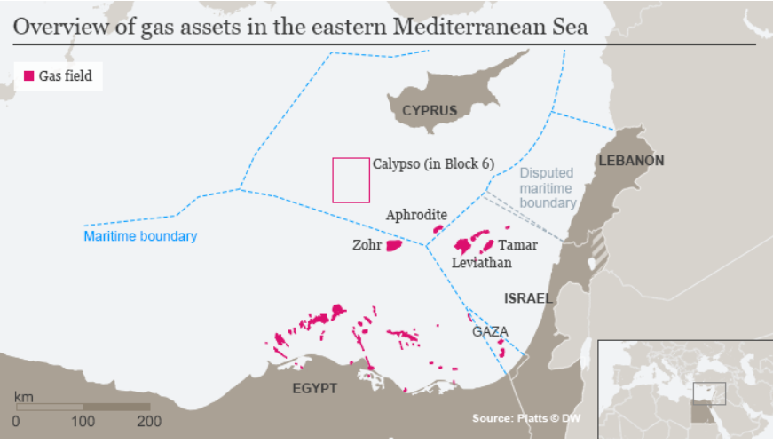
The emerging East Mediterranean gas market

Slide 37
A strong but constrained partnership
Israel participates in many other EU programmes (e.g. Galileo programme of satellite navigation, the Competitiveness and Innovation Framework Programme…)
In fact, Israel is one of the ENP countries with highest degree of access to EU programmes.
The legal basis for our relations is the 1995 Association Agreement. Our relations are further guided by the Joint ENP Action Plan adopted in 2005, which has been extended several times since then.
While the Association Agreement and 2005 ENP Action Plan provide an ambitious framework, the development of closer economic and financial relations is for the time being politically constrained, reflecting the lack of progress with the Middle East Peace Process.**
Notes:
*The Association Agreement does not include obligatory provisions on services and investment.
**In 2008, the EU decided to put on hold the further upgrading of relations with Israel following operation “Cast Lead” in Gaza. No meetings of the Association Council (highest EU-Israel dialogue level) or the Association Committee have taken place since 2012, although the sectoral subcommittees meet regularly (normally once a year).

Slide 38
An unexploited potential
In sum, the EU and Israel are close partners, cooperating in many economic areas and programmes. Perhaps more importantly, they share values, cultural affinities and a common history.
This partnership with Europe brings significant opportunities and benefits to the Israeli economy. And there is a clear potential for further strengthening it, including by extending the liberalisation to the service sector and further approximating our regulatory frameworks.*
The EU can only hope that Israel will take the steps in the political arena, notably regarding its engagement with the MEPP, that will allow us both to seize the full potential of our partnership.
In designing its political and economic strategy, the next government can help to make this happen.
Notes:
*Israel could gain from an additional approximation of its regulations in key areas such as
the financial sector, industrial standards, competition policy, energy efficiency and environmental sustainability

Slide 39
Thank you!

